Slide 1
Branch and Jump Disassembly
Christopher Mar

Slide 2
Jump Instruction Format
opcode
immediate value
6 bits
26 bits
PC = PC[31:28] + (imm << 2)
RAM: 0x10000000 to 0x10FFFFFC
First 4 bits of address always 0x1 (i.e. 0b0001)
Word (4 byte) aligned memory means the lower 2 bits always 0’s, which is why we use a shift
Save 2 bits in the immediate field

Slide 3
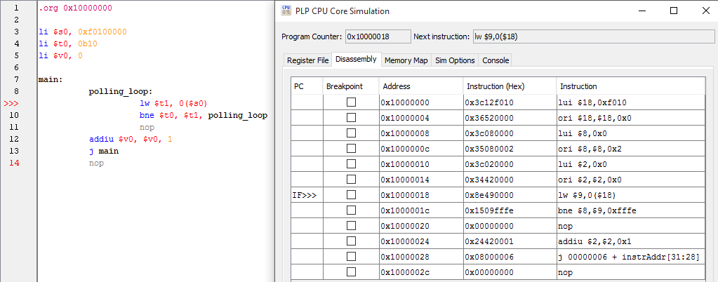
Jump Instruction Format

Slide 4
Calculate Jump Address
000010
00000000000000000000000110
6 bits
26 bits
PC = PC[31:28] + (imm << 2)
= 0x10000000 + (0b110 << 2)
= 0x10000000 + (0b11000)
= 0x10000000 + 0x18
= 0x10000018

Slide 5
Branch Instruction Format
opcode
rs
rt
offset
6 bits
5 bits
5 bits
16 bits
The value in rs and rt indicate which registers to compare
5 bits can represent 32 numbers
PLP has 32 registers

Slide 6
Branch Instruction Format
opcode
rs
rt
offset
6 bits
5 bits
5 bits
16 bits
Offset is the signed value
Number of instructions from the branch delay slot address to the label address
Offset is shifted left 2 bits (multiply by 4, size of a word) and added to the current PC value

Slide 7
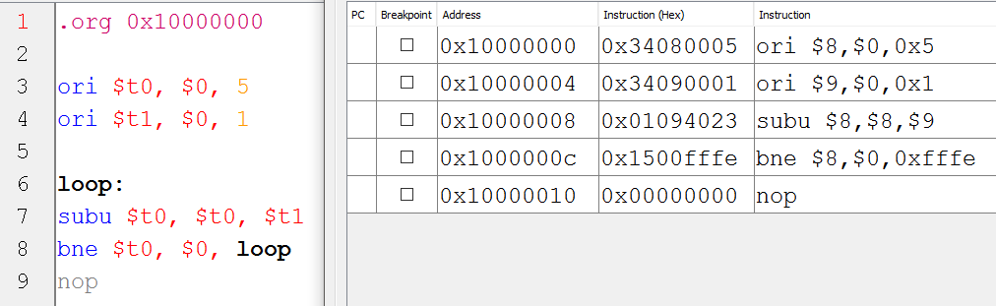
Branch Offset

Slide 8
Calculate Branch Offset
000101
01000
00000
1111 1111 1111 1110
opcode
rs
rt
offset
Offset: 0xFFFE is the signed value -2
When branch is executed the PC is set to the current PC address plus -8 (-2 << 2 = -8)
Offsets can also be positive if the target label is after the current instruction

Slide 9
Thanks for Watching

